Slide 1
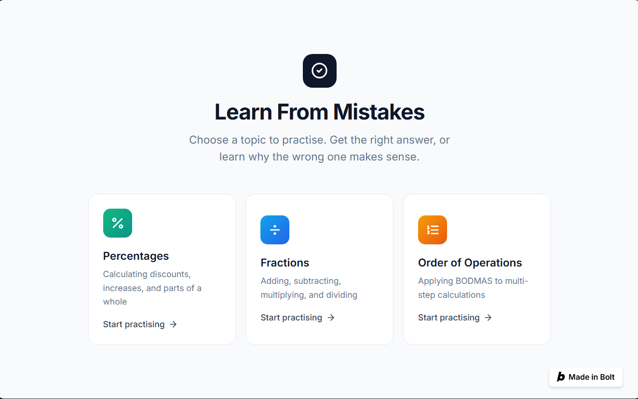
SDG 4 · Quality Education
Learn From
Mistakes
Understand why you were wrong — not just what the right answer is.
AI for Good — Hackathon 1
Built with Bolt.new · 1-week prototype
Core idea
Wrong answer → reasoning → misconception → retry

Slide 2
The problem
Getting the correct answer is not the same as understanding the mistake.
1
2
3
A student answers incorrectly
The misconception stays hidden
Feedback needs to lead to learning
Most practice tools can show that an answer is wrong, but not why the learner made that mistake.
The learner may repeat the same error because the reasoning behind it was never addressed.
We wanted to check whether the learner can apply the explanation on a similar question.
Target group: students aged 12–14 who struggle with basic maths and often repeat common mistakes.

Slide 3
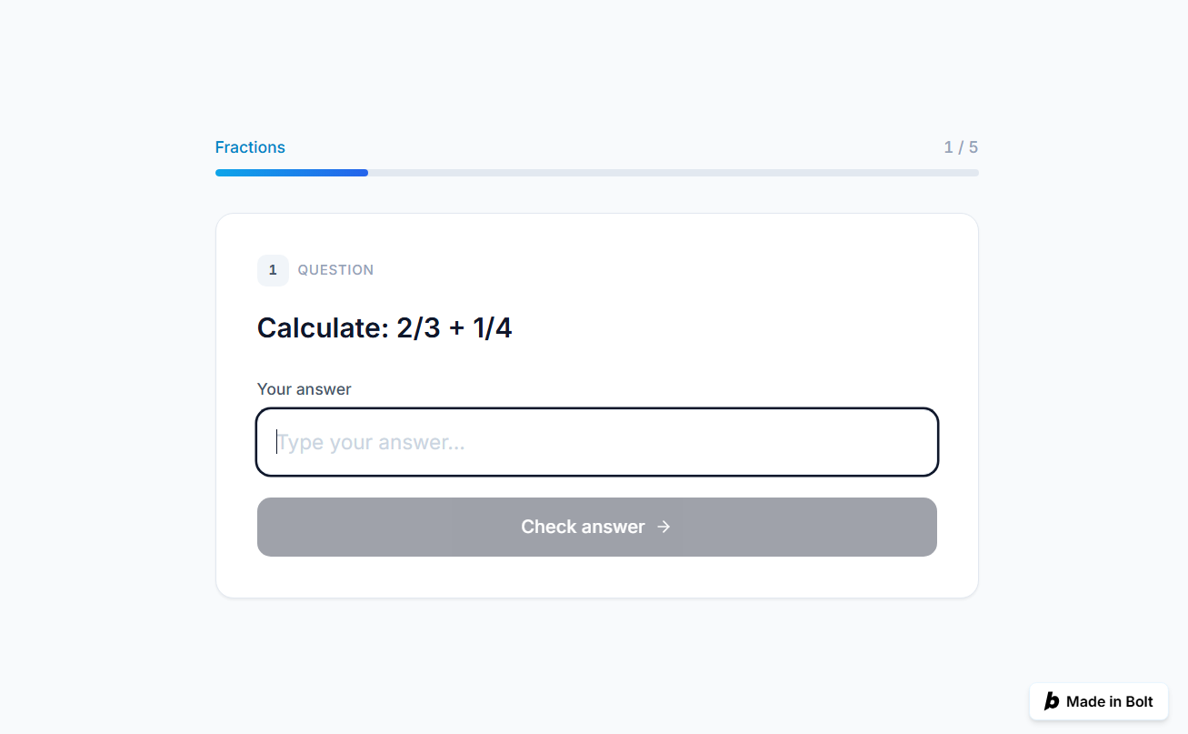
Our solution
A short learning loop built around the reason behind the wrong answer.
1
Choose a topic
→
2
Answer a question
→
3
Explain your reasoning
→
4
Get misconception feedback
→
5
Try a similar question
3 practice areas: Percentages · Fractions · Order of Operations

Slide 4
How we measure improvement
Progress is based on performance after feedback — not just completed questions.
Baseline
Student attempts the original question.
Example
1
Initial accuracy
40%
Follow-up accuracy
80%
2
Diagnose
A likely misconception is identified from the answer/reasoning.
3
Teach
The app explains the correct method in simple steps.
What the dashboard tracks
Accuracy per topic
4
Check
A similar follow-up question tests whether the idea was understood.
Common misconceptions
Corrected mistakes

Slide 5
Ethical reflection
The app can support learning, but it also creates access, privacy and reliability questions.
Who could be excluded?
What does it assume?
Learners without a reliable device or internet, non-English speakers, and students who need accessibility features not yet included.
That a learner has basic maths knowledge, can explain their reasoning in writing, and that a short explanation reveals the real misconception.
How could it be misused?
How we reduce the risk
Students could use it only for answers, automated feedback could be trusted too much, and parent access could become intrusive monitoring.
Attempt first, reasoning before solution, follow-up check, limited learning data, a delete-data option, feedback/reporting, and parent summaries instead of private reasoning.
Prototype note: student reasoning is currently analysed locally with predefined patterns, not sent to an external AI model.

Slide 6
Live demo + what we learned
The main flow can be demonstrated in under two minutes.
Demo flow
What we learned
1
Open Fractions
AI builders can produce a working product very quickly.
2
Answer 2/3 + 1/4 as 3/7
The first generated version is not automatically correct.
3
Explain: “I added the numerators and denominators.”
Specific prompts work better than vague “make it better” requests.
4
Show the misconception explanation
Testing navigation, state and data logic still matters.
5
Solve 1/2 + 1/5 as 7/10
Show the updated progress
Ethical choices are part of product design, not an afterthought.
6
“AI can build fast — but we still have to define, test and judge what it builds.”

